Slide 1

Gastro-intestinal
Disease Prediction

Slide 2
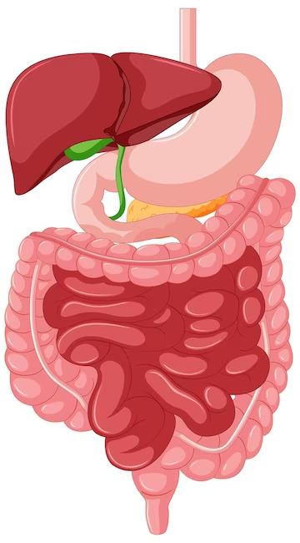
About
Gastrointestinal (GI) diseases are widespread and strain healthcare systems. These conditions create patient discomfort and can lead to serious health problems.
Traditional diagnosis often uses invasive endoscopies. These procedures are expensive, time-consuming, and uncomfortable.
This project develops an image-based, machine learning tool to classify GI diseases. It aims to be a non-invasive solution to aid medical professionals.
A successful system could enhance diagnosis, increase accessibility of expert knowledge, reduce the need for endoscopies, and improve healthcare efficiency.
We need a reliable, efficient way to classify GI diseases using endoscopic images to support faster, more accurate diagnoses.

Slide 3
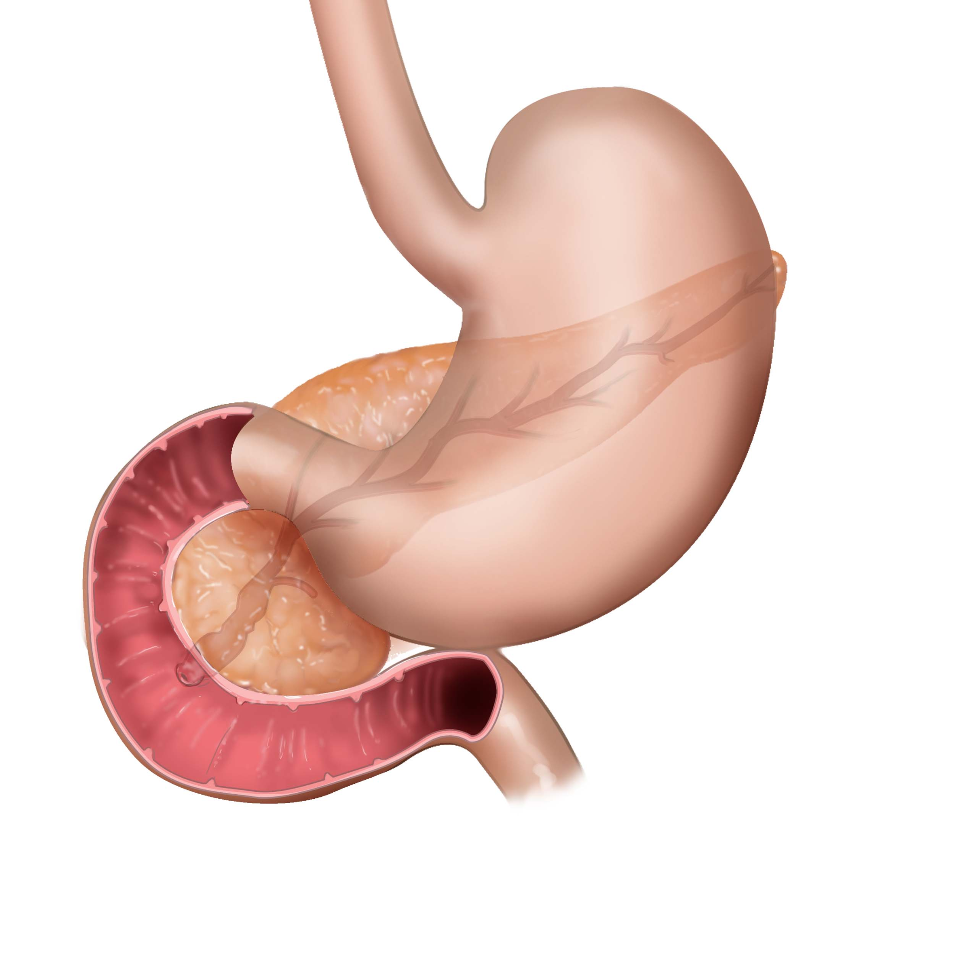
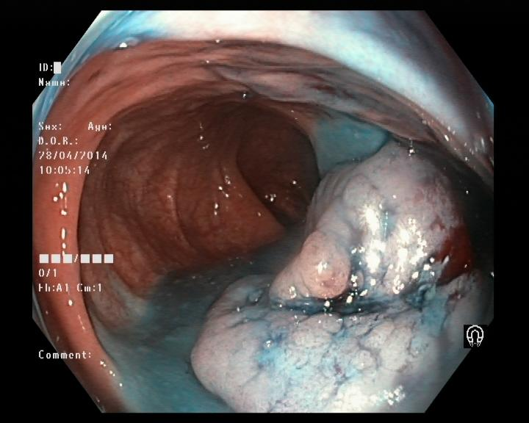
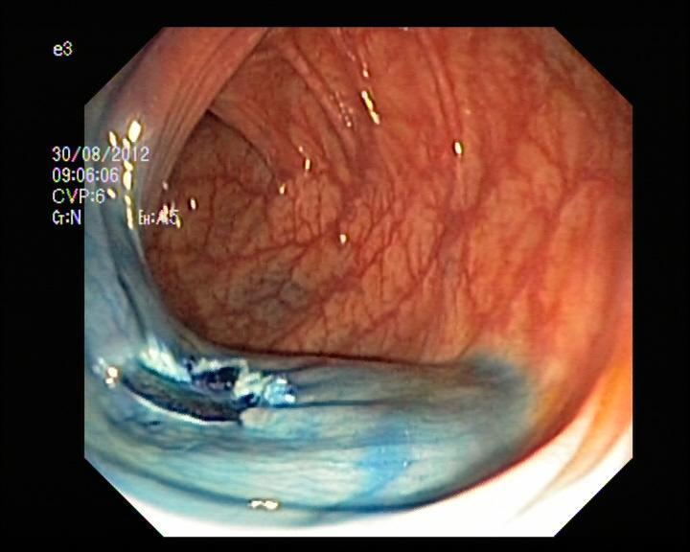
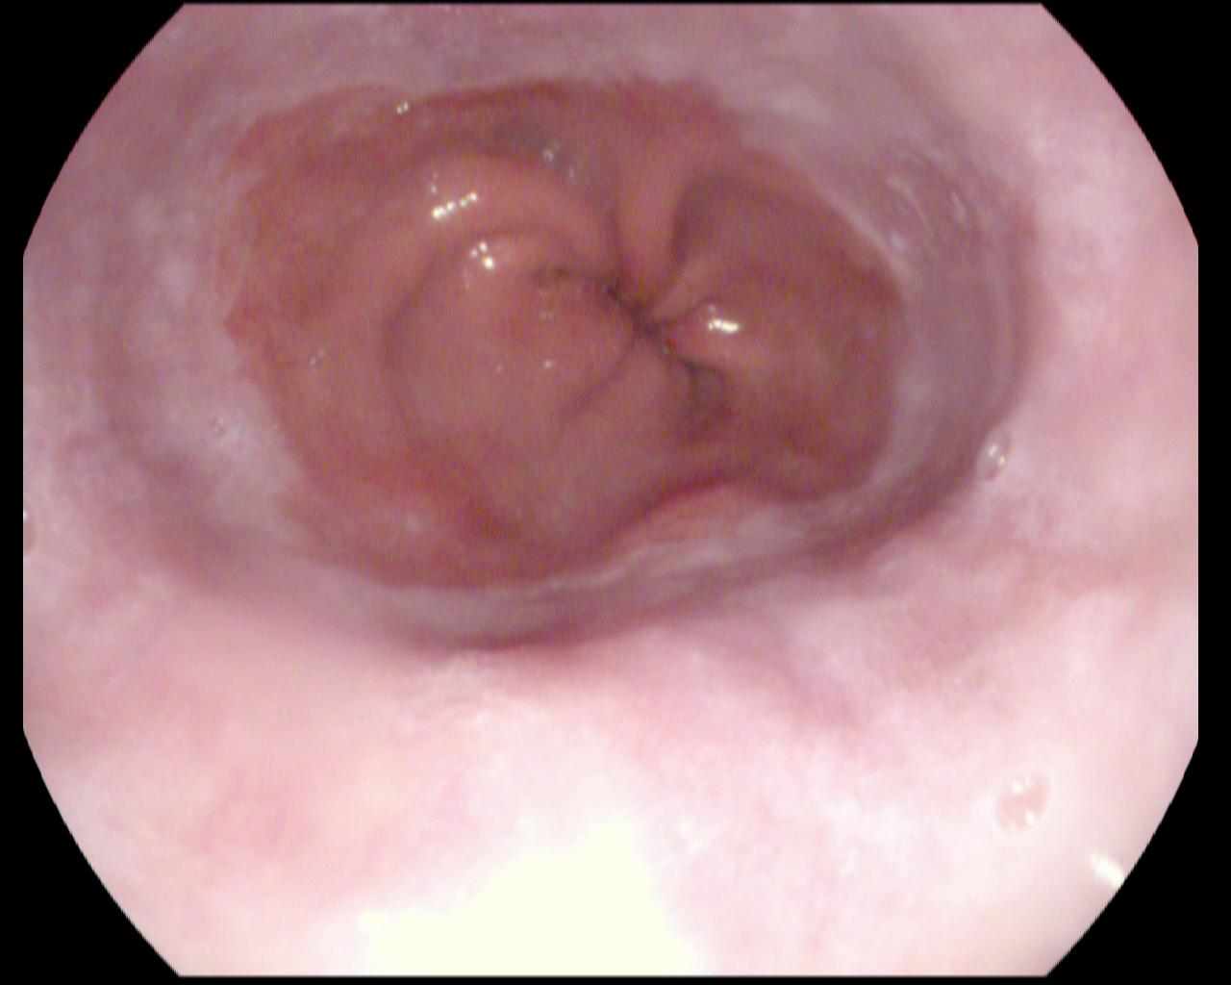
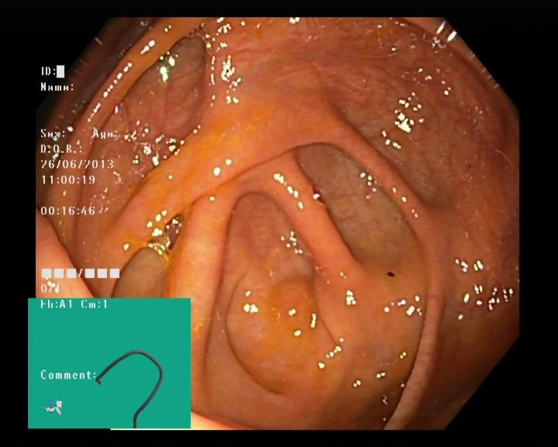
Diseases
Dyed-Lifted Polyps
Dyed-Resection-Margins
Esophagitis
Normal-Cecum
Dyed-Lifted-Polyps: Images of polyps that have been stained with dye to improve visualization and then removed during an endoscopy.
Dyed-Resection-Margins: Images showing the edges of tissue after a polyp has been removed during an endoscopy.
Esophagitis: Images showing inflammation or irritation of the esophagus.
Normal-Cecum: Images of a healthy cecum, the pouch-like beginning of the large intestine.

Slide 4
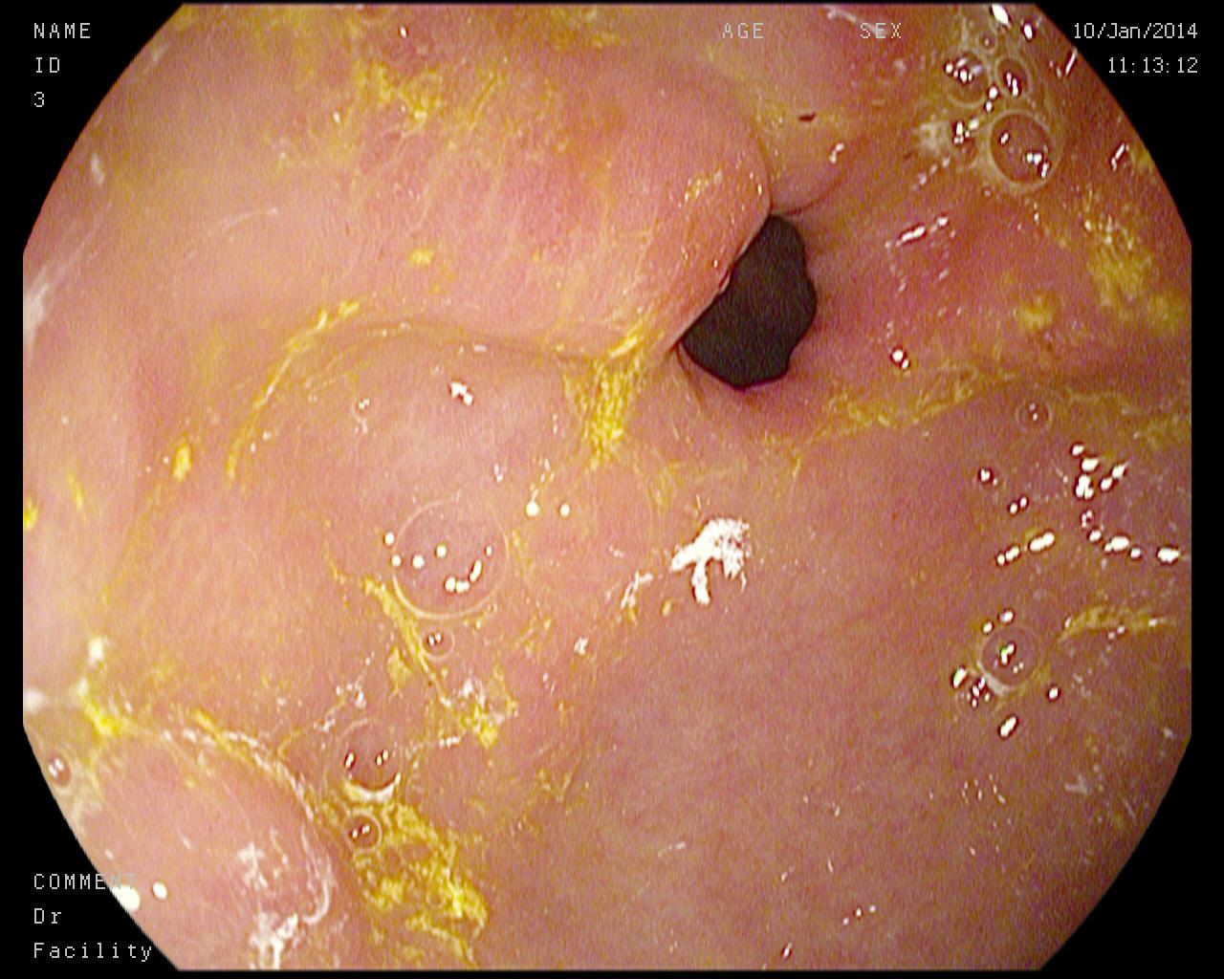
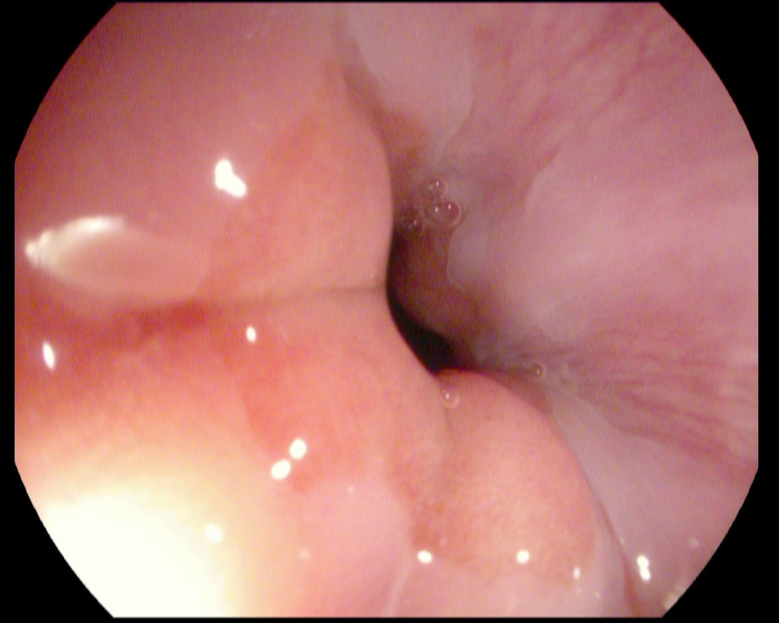
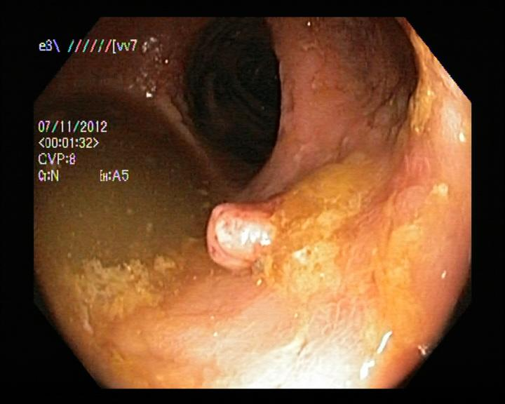
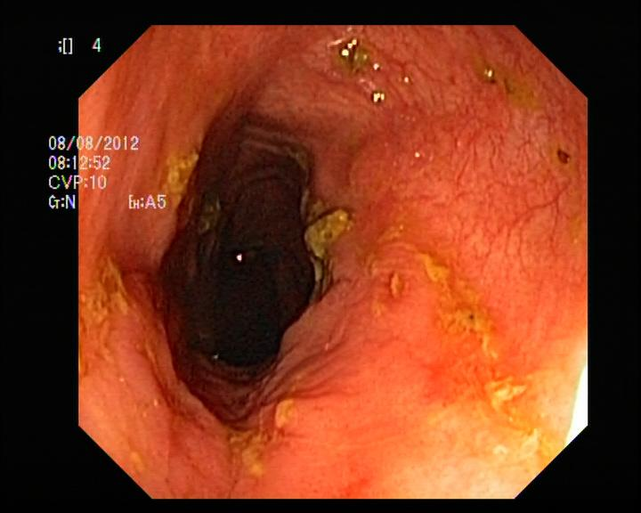
Diseases
Normal-Pylorus
Normal-Z-Line
Polyps
Ulcerative-Colitis
Normal-pylorus: Images of a healthy pylorus, the muscular valve connecting the stomach to the small intestine.
Normal-z-line: Images of a healthy z-line, the squiggly line marking the transition between the esophagus and the stomach.
Polyps: Images of polyps, which are growths on the lining of the colon or rectum.
Ulcerative-colitis: Images showing inflammation and ulcers in the colon and rectum, characteristic of this chronic inflammatory bowel disease.

Slide 5

Dataset
KVASIR Dataset:
A Multi-Class Image Dataset for Computer Aided Gastrointestinal Disease Detection
Link : https://www.kaggle.com/datasets/meetnagadia/kvasir-dataset/data
The dataset consists of 4000 images, where 500 images belonging to each class of diseases discussed.

Slide 6

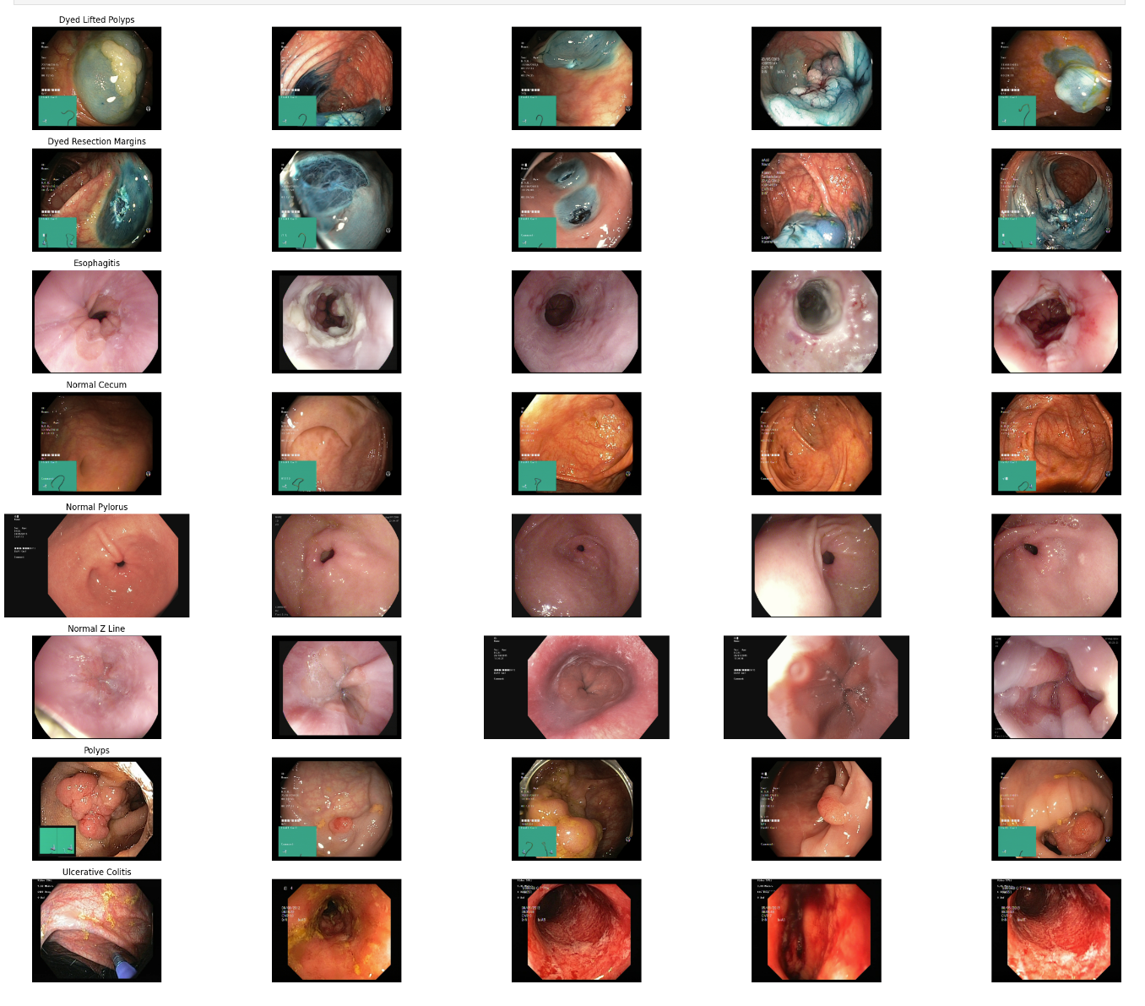
Data
Sample Images from Dataset:

Slide 7

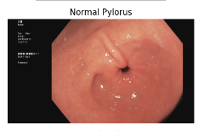
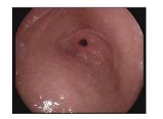
Data Preprocessing
Data exploration revealed that all the images have different sizes , hence making it difficult during defining the model parameters. Hence we reduce to the image size to ensure reproducibility.
Since our model requires images in RGB format, we convert them from BGR to RGB using the cv2.COLOR_BGR2RGB function in Python, ensuring compatibility with the model’s input requirements.
THANK YOU MR. MUSK!

Slide 8
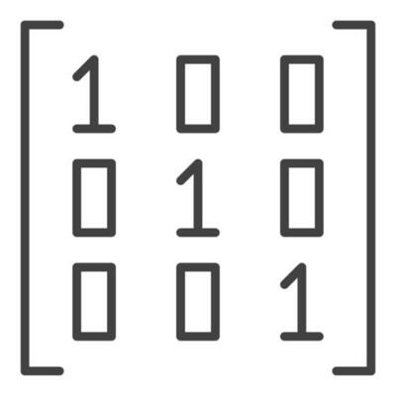
Disease Labels
Label Number | Disease Name
0 | Dyed-Lifted-Polyps
1 | Dyed-Resection-Margins
2 | Esophagitis
3 | Normal-Cecum
4 | Normal-Pylorus
5 | Normal-Z-Line
6 | Polyps
7 | Ulcerative-Colitis

Slide 9

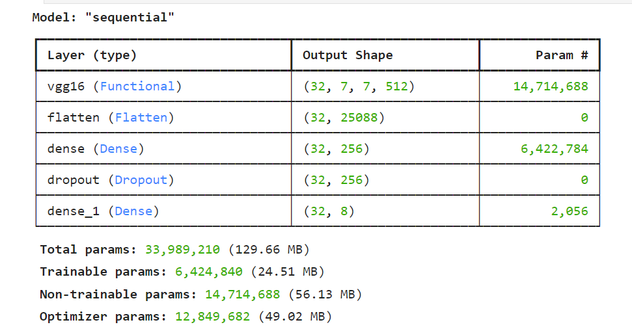
Model One - VGG16
Base Model: Utilizes VGG16, a powerful pre-trained convolutional neural network.
Architecture:
Input: 224x224 RGB image
Convolutional Blocks:
Multiple convolutional layers (with 3x3 filters)
Max-pooling layers for downsampling
Fully Connected Layers:
Layers to map the extracted features to the final output classes
Output: 1000-dimensional vector (corresponding to 1000 ImageNet classes)
Total Parameters: 33,989,210
Trainable Parameters: 6,424,840
Non-trainable Parameters: 14,714,688

Slide 10
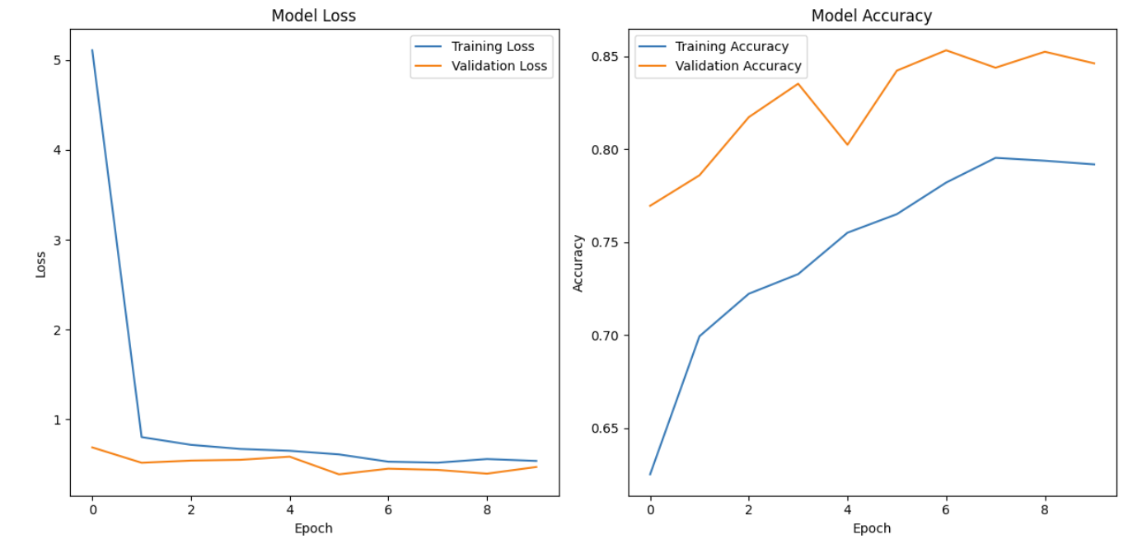
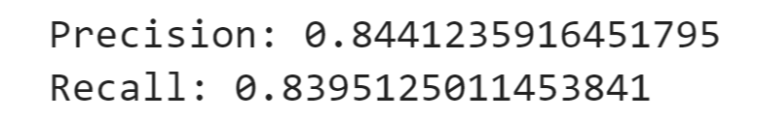
Model One - VGG16

Slide 11
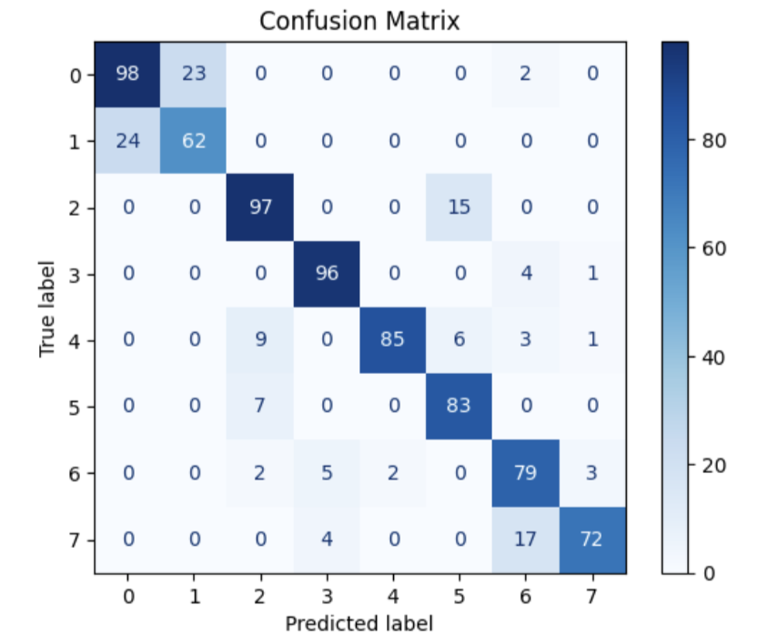
Model One - VGG16
High Correct Predictions:
The model accurately predicted 'dyed-lifted-polyps' (98), 'esophagitis' (97), and ‘normal-cecum’ (96) with high counts, indicating strong performance in recognizing these classes.
Confusion between Similar Classes:
Confusion occurred between 'dyed-lifted-polyps' and 'dyed-resection-margins' (24 instances), and between 'polyps and 'ulcerative-colitis' (17 instances). This suggests similarities or overlapping features between these classes, leading to misclassifications.
Rare Misclassifications:
Some classes experienced rare misclassifications, such as 'normal-z-line' being predicted as 'esophagitis' (15 instances) and 'normal-pylorus' being predicted as 'esophagitis' (9 instances), indicating potential areas for model improvement.

Slide 12
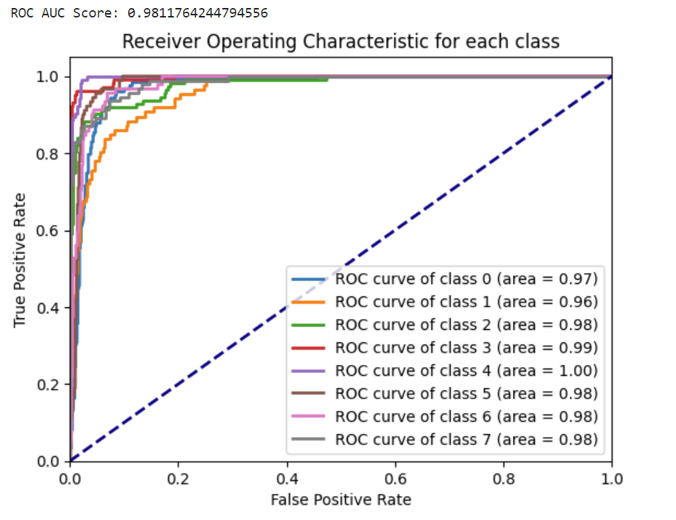
Model One - VGG16
ROC Plot

Slide 13
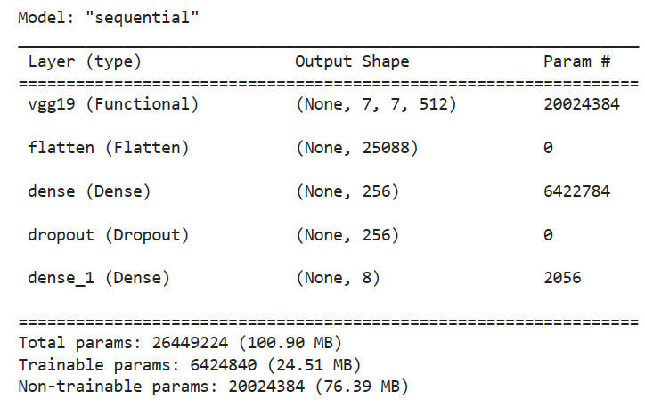
Model Two - VGG19
Base Model: Utilizes VGG19, a powerful pre-trained convolutional neural network.
Additional Layers:
Flatten Layer: converts the multi-dimensional output of a convolutional or pooling layer into a one-dimensional array or vector.
Dense Layer: computes a weighted sum of its inputs from the previous layer, adds a bias term, and then applies an activation function.
Dropout: Prevents overfitting by randomly deactivating some units during training.
Total Parameters: 26,449,224
Trainable Parameters: 6,424,840
Non-trainable Parameters: 20,024,384

Slide 14
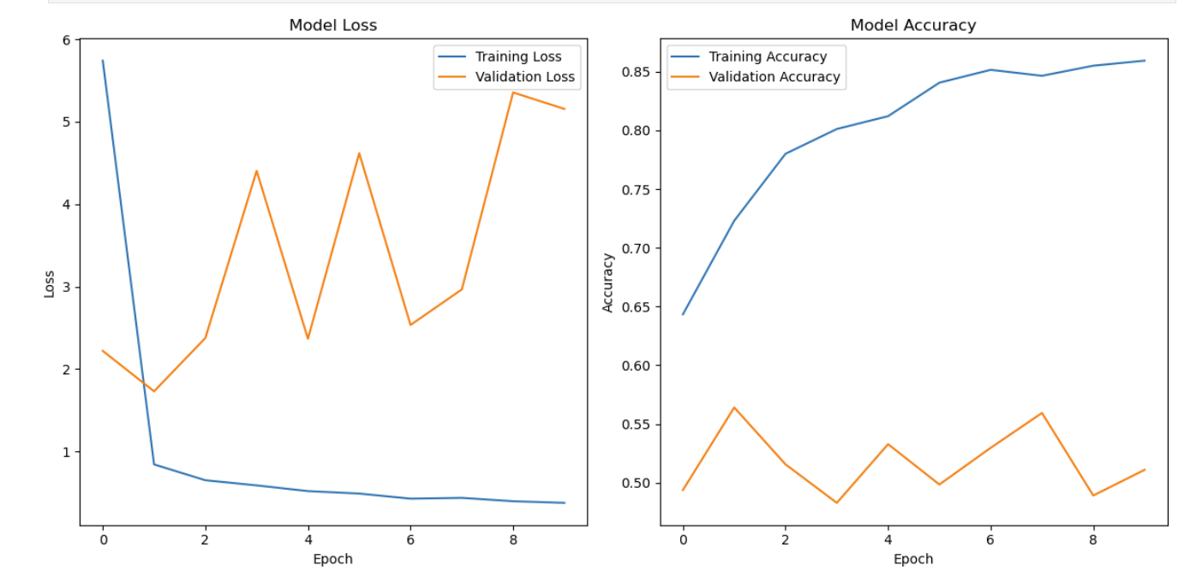
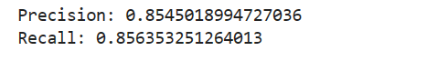
Model Two - VGG19

Slide 15
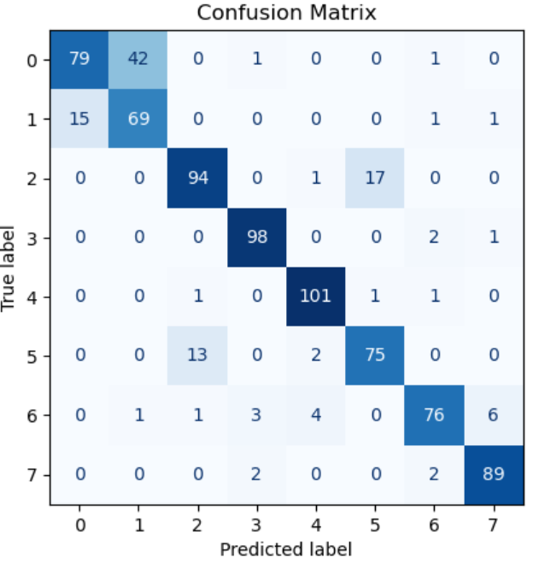
Model Two - VGG19
High Correct Predictions:
The model accurately predicted 'normal-pylorus' (101), 'normal-cecum' (98), and esophagitis' (94) with high counts, indicating strong performance in recognizing these classes.
Confusion between Similar Classes:
Confusion occurred between 'dyed-lifted-polyps' and 'dyed-resection-margins' (42 instances), and between 'normal-cecum' and 'polyps' (2 instances). This suggests similarities or overlapping features between these classes, leading to misclassifications.
Rare Misclassifications:
Some classes experienced rare misclassifications, such as 'normal-z-line' being predicted as 'esophagitis' (17 instances) indicating potential areas for model improvement.
Misclassification of Rare Classes:
The class 'esophagitis' was occasionally misclassified as 'normal-z-line' (13 instances), possibly due to their similar visual characteristics, requiring further investigation to improve the model's performance on distinguishing between them.

Slide 16
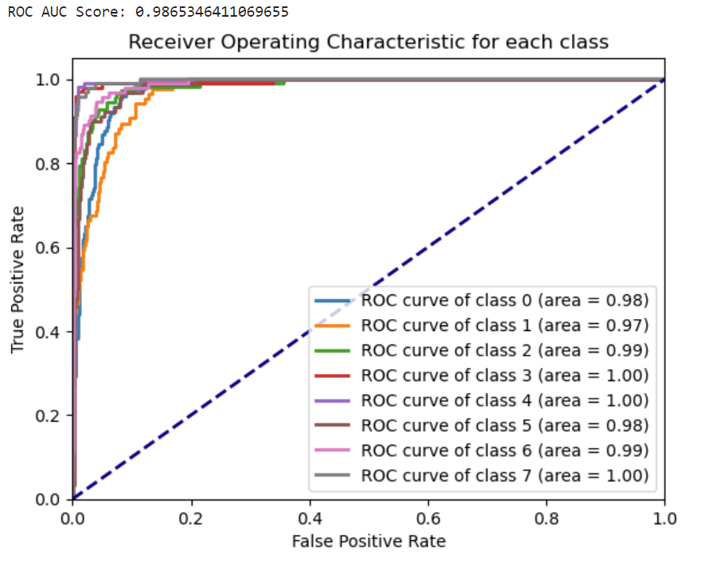
Model Two - VGG19
ROC Plot

Slide 17
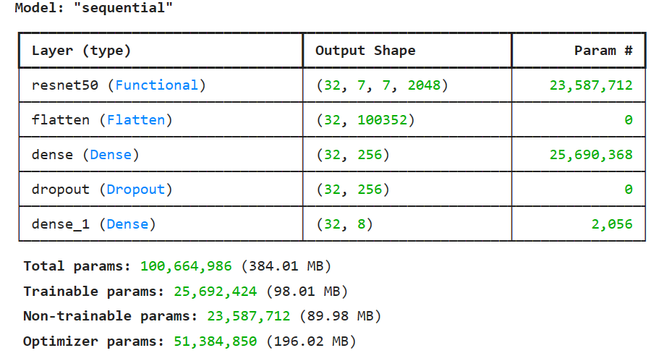
Model Three - RESNET50
Base Model: Utilizes ResNet50, a powerful pre-trained convolutional neural network.
Additional Layers:
Flatten Layer: converts the multi-dimensional output of a convolutional or pooling layer into a one-dimensional array or vector.
Dense Layer: computes a weighted sum of its inputs from the previous layer, adds a bias term, and then applies an activation function.
Dropout: Prevents overfitting by randomly deactivating some units during training.
Total Parameters: 100,664,986
Trainable Parameters: 25,692,424
Non-trainable Parameters: 23,587,712

Slide 18
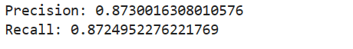
Model Three - RESNET50

Slide 19
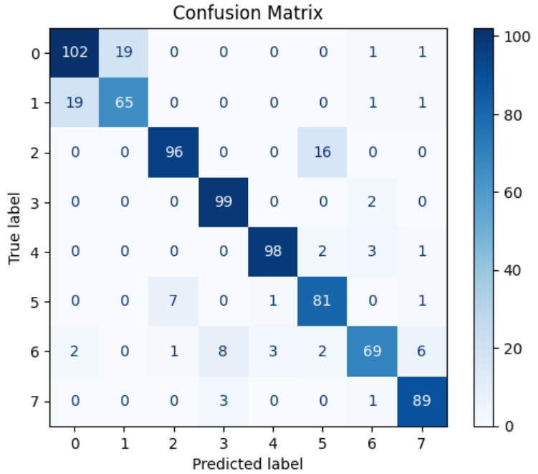
Model Three - RESNET50
High Correct Predictions:
The model accurately predicted 'dyed lifted polyps' (102), 'normal-cecum’' (99), and 'normal pylorus' (98)’with high counts, indicating strong performance in recognizing these classes.
Confusion between Similar Classes:
Confusion occurred between 'dyed-lifted-polyps' and 'dyed-resection-margins' (19 instances), and between 'normal-cecum' and 'ulcerative-colitis' (2 instances). This suggests similarities or overlapping features between these classes, leading to misclassifications.
Rare Misclassifications:
Some classes experienced rare misclassifications, such as 'normal-z-line' being predicted as 'esophagitis' (7 instances) and 'polyps' being predicted as 'normal-cecum' (8 instances), indicating potential areas for model improvement.
Misclassification of Rare Classes:
The class 'esophagitis' was occasionally misclassified as 'normal-z-line' (16 instances), possibly due to their similar visual characteristics, requiring further investigation to improve the model's performance on distinguishing between them.

Slide 20
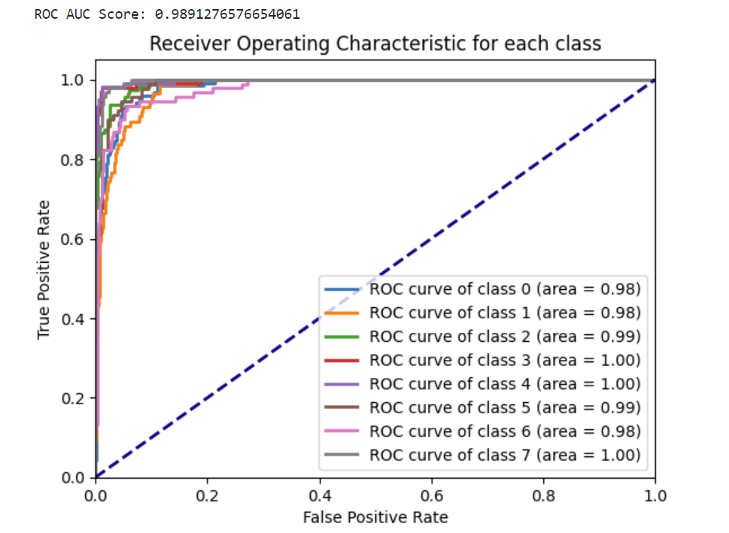
Model Three - RESNET50
ROC Plot

Slide 21
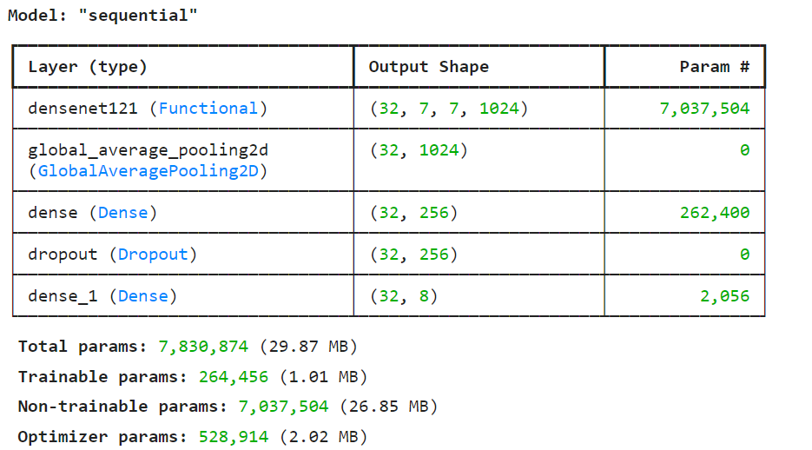
Model Four - DENSENET121
Base Model: Utilizes DenseNet121, a powerful pre-trained convolutional neural network.
Additional Layers:
GlobalAveragePooling2D: Reduces spatial dimensions while retaining important information.
Dense Layer: Adds non-linearity to the model with 256 units and ReLU activation function.
Dropout: Prevents overfitting by randomly deactivating some units during training.
Total Parameters: 7,830,874
Trainable Parameters: 264,456
Non-trainable Parameters: 7,037,504

Slide 22
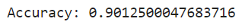
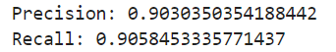
Model Four - DENSENET121

Slide 23
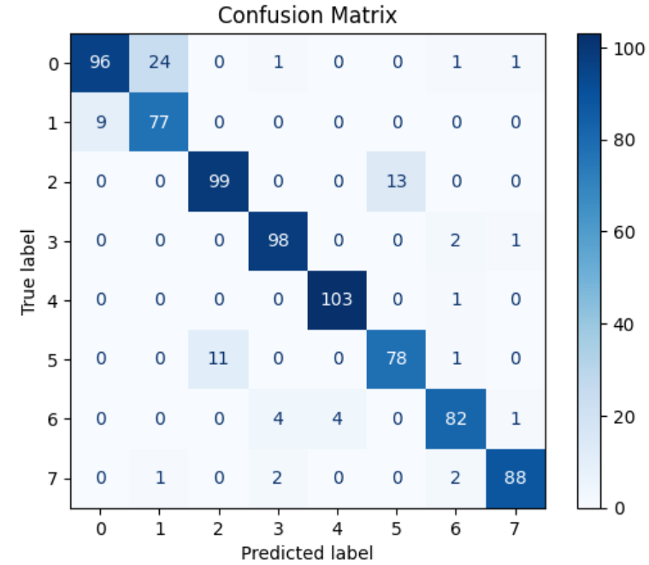
Model Four - DENSENET121
High Correct Predictions:
The model accurately predicted 'normal-pylorus' (103), and ulcerative-colitis' (88) with high counts, indicating strong performance in recognizing these classes.
Confusion between Similar Classes:
Confusion occurred between 'dyed-lifted-polyps' and 'dyed-resection-margins' (24 instances), and between 'normal-cecum' and 'ulcerative-colitis' (2 instances). This suggests similarities or overlapping features between these classes, leading to misclassifications.
Rare Misclassifications:
Some classes experienced rare misclassifications, such as 'normal-z-line' being predicted as 'esophagitis' (11 instances) and 'polyps' being predicted as 'normal-cecum' (4 instances), indicating potential areas for model improvement.
Misclassification of Rare Classes:
The class 'esophagitis' was occasionally misclassified as 'normal-z-line' (13 instances), possibly due to their similar visual characteristics, requiring further investigation to improve the model's performance on distinguishing between them.

Slide 24
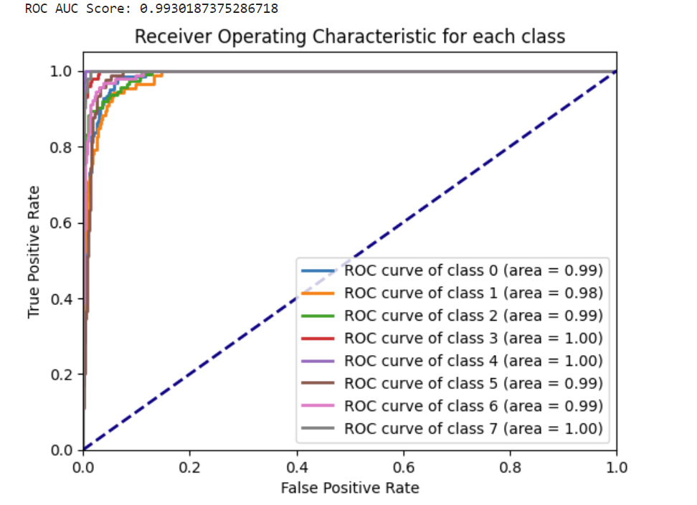
Model Four - DENSENET121
ROC Plot

Slide 25
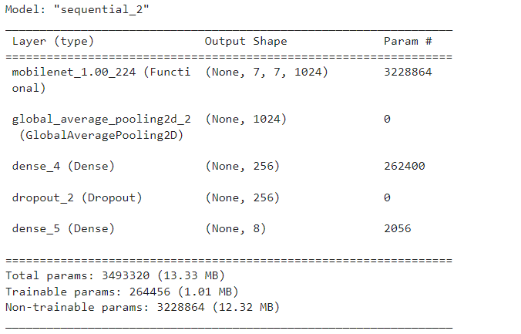
Model Five - MOBILENET
Base Model: Utilizes Mobilenet, a powerful pre-trained convolutional neural network optimised for mobile applications
Additional Layers:
Global_Average_Pooling Layer:This layer reduces each of the incoming feature map's dimensions to a single value, condensing the spatial information, thus lowering the model's complexity and total parameter count.
Dense Layer: computes a weighted sum of its inputs from the previous layer, adds a bias term, and then applies an activation function.
Dropout: Prevents overfitting by randomly deactivating some units during training.
Total Parameters: 3,493,320
Trainable Parameters: 264,456
Non-trainable Parameters: 3,228,864
Notes:
MobileNets primarily use depthwise separable convolutions in place of the standard convolutions used in earlier architectures to build lighter models.
The images are of size 224*224, making up total parameters of 3,493,320.
MobileNets are built on depthwise separable convolution layers. Each depthwise separable convolution layer consists of a depthwise convolution and a pointwise convolution. Counting depthwise and pointwise convolutions as separate layers, a MobileNet has 28 layers. A standard MobileNet has 4.2 million parameters which can be further reduced by tuning the width multiplier hyperparameter appropriately.
Depthwise Convolution: This performs a single convolution for each input channel.
Pointwise Convolution: This is a 1x1 convolution that combines the outputs of the depthwise convolution.
The depthwise separable convolution is more efficient than traditional convolutions (used in widthwise or broad convolutions) since it reduces the number of parameters and computations. The MobileNet architecture is particularly known for this feature, and it is what makes it lightweight and suitable for mobile and edge devices.
Architecture: They use depthwise separable convolutions which factorize a standard convolution into a depthwise convolution and a 1x1 convolution called a pointwise convolution. This reduces the computational cost and the model size.
Use Cases: Because of their small size and high efficiency, MobileNets are ideal for applications on mobile devices, such as real-time image recognition and classification, face detection, and augmented reality.

Slide 26
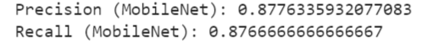
Model Five - MOBILENET
Notes:
Precision measures the accuracy of the positive predictions made by the model. It is the proportion of true positive predictions in the total predicted positives. Precision is a good measure to determine when the costs of false positives are high. In mathematical terms, precision is defined as:
Precision = TP/TP+FP
Recall (also known as sensitivity or true positive rate) measures the model's ability to identify all relevant instances in the dataset. It is the proportion of true positives that were identified correctly by the model in the total actual positives. Recall is a good measure to determine when the costs of false negatives are high. In mathematical terms, recall is defined as:
Recall=True Positives/True Positives+False Negatives
High recall means that the model returned most of the relevant results.
Test accuracy tells how much of the test data is the model able to classify accurately.

Slide 27
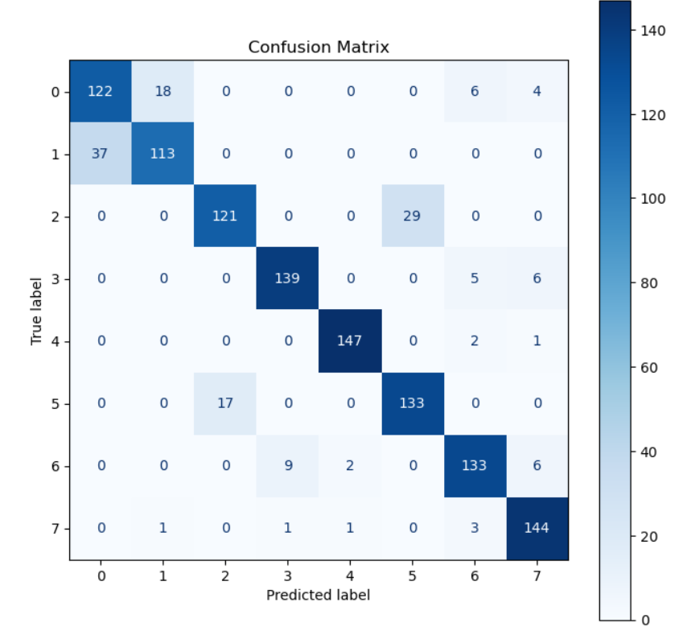
Model Five - MOBILENET
High Correct Predictions:
The model accurately predicted 'normal-pylorus' (147), 'normal-z-line' (133), and ulcerative-colitis' (144) with high counts, indicating strong performance in recognizing these classes.
Confusion between Similar Classes:
A noticeable confusion was observed between 'esophagitis' and 'normal-z-line' with 29 instances misclassified. Confusion occurred between 'dyed-lifted-polyps' and 'dyed-resection-margins' (37 instances).This pattern has been predominant over the other cases as well
Rare Misclassifications:
There were rare instances of misclassification across various classes, such as 'dyed-lifted-polyps' being mistaken for 'ulcerative-colitis' and 'normal-cecum' confused with 'normal-pylorus', each with a few cases.
Misclassification of Rare Classes:
The class 'esophagitis' was occasionally misclassified as 'normal-z-line' (29 instances), possibly due to their similar visual characteristics, requiring further investigation to improve the model's performance on distinguishing between them.
Notes:
True Positives (TP): The cases in which the model correctly predicted the positive class.
True Negatives (TN): The cases in which the model correctly predicted the negative class.
False Positives (FP): The cases in which the model incorrectly predicted the positive class (also known as a "Type I error").
False Negatives (FN): The cases in which the model incorrectly predicted the negative class (also known as a "Type II error").
True label and predicted label for n*n classes.
Why does misclassification occur

Slide 28
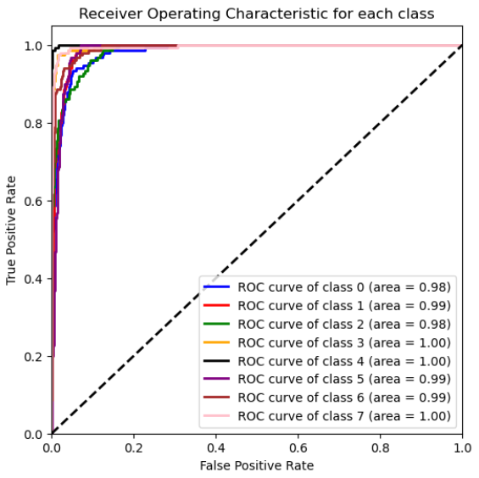
Model Five - MOBILENET
ROC Plot
Notes:
The mobilenet is able to properly detect the Normal-Cecum(class 3),Normal-Pylorus (class 4), Ulcerative-Colitis (class 7) .
The receiver operating characteristic curve shows the performance of the classification model usually True Positives against type 1 error (FP).

Slide 29
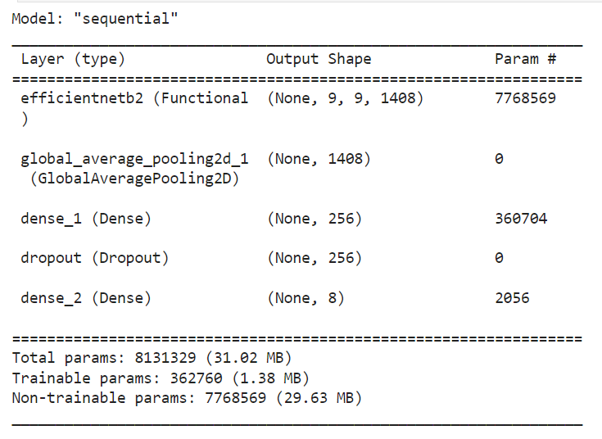
Model Six - EFFICIENTNET
Base Model: Utilizes efficientNet_B2, a powerful pre-trained convolutional neural network optimised for classification of larger datasets
Additional Layers:
Global_Average_Pooling Layer:This layer reduces each of the incoming feature map's dimensions to a single value, condensing the spatial information, thus lowering the model's complexity and total parameter count.
Dense Layer: computes a weighted sum of its inputs from the previous layer, adds a bias term, and then applies an activation function.
Dropout: Prevents overfitting by randomly deactivating some units during training.
Total Parameters: 8,131,329
Trainable Parameters:362,760
Non-trainable Parameters: 7,768,569
Notes:
EfficientNet is a convolutional neural network architecture and scaling method that uniformly scales all dimensions of depth/width/resolution using a compound coefficient.
The rectified linear unit (ReLU) or rectifier activation function introduces the property of nonlinearity to a deep learning model and solves the vanishing gradients issue.
Design Philosophy: EfficientNets focus on scaling all dimensions of the model (depth, width, and resolution) uniformly using a compound coefficient. This way, they manage to achieve better accuracy and efficiency compared to other CNNs.
Architecture: They utilize a baseline network (EfficientNet-B0) that's scaled up to obtain the subsequent versions (B1 to B7) using the compound scaling method. EfficientNets also use depthwise separable convolutions with some modifications and include squeeze-and-excitation blocks.
Use Cases: EfficientNets are used in scenarios where high accuracy is required without a significant increase in model size or computational power. They are versatile and can be applied to a range of tasks from image classification to object detection and beyond.

Slide 30
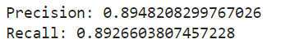
Model Six - EFFICIENTNET

Slide 31
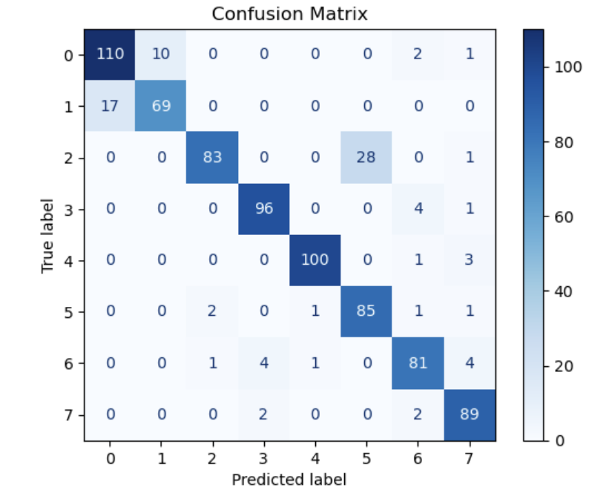
Model Six - EFFICIENTNET
High Correct Predictions:
The model accurately predicted 'dyed-lifted-polyps' with 110 correct instances, 'normal-cecum' with 96 instances, and 'normal-pylorus' with 100 instances, showing a strong ability to recognize these classes.
Confusion between Similar Classes:
There is notable confusion between 'dyed-lifted-polyps' and 'dyed-resection-margins', with 17 instances misclassified as 'dyed-resection-margins'. Additionally, 'normal-cecum' was occasionally mistaken for 'esophagitis' in 28 cases.
Rare Misclassifications:
Rare misclassifications can be observed in instances where 'dyed-lifted-polyps' were incorrectly predicted as 'ulcerative-colitis', and 'normal-z-line' mistaken for 'normal-cecum', both with only a few cases. These highlight specific instances where the model's performance could be improved.
Misclassification of Rare Classes:
'Polyps' were sometimes confused with 'normal-pylorus' and 'ulcerative-colitis', with a few misclassifications noted. This misidentification suggests that 'polyps' may share similar characteristics with these classes or that there may be a need for better representation in the training data for 'polyps'.

Slide 32
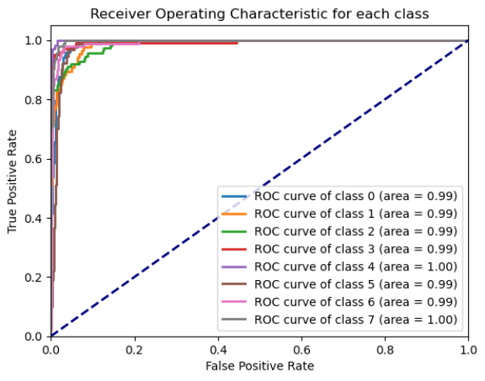
Model Six - EFFICIENTNET
ROC Plot

Slide 33

Summary
Model Number | Model Name | Test Accuracy | Precision | Recall | Mean Cross Validation Accuracy
1 | VGG16 | 0.839999973 | 0.8441235916 | 0.8395125011 | 0.816015625
2 | VGG19 | 0.851249992 | 0.8545018994 | 0.8563532512 | 0.808984375
3 | RESNET50 | 0.873749971 | 0.8730016306 | 0.8724952276 | 0.847265625
4 | DENSENET121 | 0.901250004 | 0.9030350354 | 0.9058453335 | 0.855078125
5 | MOBILENET | 0.876666665 | 0.8776335932 | 0.8766666667 | 0.8732265999
6 | EFFICIENTNET | 0.891250014 | 0.8948208299 | 0.8926603807 | 0.888671875

Slide 34

Observations
Misclassifications Analysis:
Misclassifications primarily occur between classes with similar visual features. For instance, Dyed-Lifted-Polyps (Class 0) and Dyed-Resection-Margins (Class 1) often share similar color and texture once stained, leading to confusion.
The varying shades and inflammation levels in Esophagitis (Class 2) can resemble the normal tissue appearance, causing confusion with the Normal-Z-Line (Class 5).
Ulcerative-Colitis (Class 7) can sometimes present with less pronounced visual symptoms, leading to misidentification as Normal-Cecum or Polyps (Class 6), depending on the severity and imaging clarity.

Slide 35
Observations
Model-Specific Performance:
VGG16 has shown commendable performance in identifying Normal-Cecum (Class 3), with high correct predictions and fewer misclassifications.
VGG19 has excelled in accurately classifying Normal-Cecum (Class 3) and Normal-Pylorus (Class 4), evidenced by its almost perfect prediction rate.
ResNet50 has demonstrated strong performance across most classes, with particularly high accuracy for Normal-Cecum (Class 3) and Normal-Pylorus (Class 4).
DenseNet121 stands out in its ability to distinguish between Normal-Cecum (Class 3), Normal-Pylorus (Class 4) and Ulcerative-Colitis (Class 7) with high accuracy.
MobileNet offers the best performance for Normal-Pylorus (Class 4)) and Ulcerative-Colitis (Class 7), indicating its strength in differentiating subtle textural differences.
EfficientNet shows an impressive ability to correctly classify Dyed-Lifted-Polyps (Class 0), suggesting it might be best for datasets where this class is predominant.

Slide 36
Observations
Overall Best Model Considerations:
No single model uniformly outperforms others across all classes; thus, the choice of model may depend on the specific clinical requirements and the prevalence of certain conditions in the target population.
Ensemble methods that combine predictions from multiple models might be explored to leverage the strengths of individual models, potentially leading to better overall accuracy and robustness.

Slide 37

Conclusion
Our comparative analysis of six models on the KVASIR dataset for gastrointestinal disease prediction has yielded important insights:
Misclassifications occurred mostly between classes with similar visual characteristics, suggesting a need for improved feature extraction methods.
Some models have exhibited strength in some classes
Overall, no single model outperformed the others across all disease classes. The choice of the model should be informed by the specific clinical needs and the prevalence of diseases in the patient population.
The findings advocate for the potential of using machine learning as a support tool in gastroenterology, promising enhancements in diagnosis accuracy and patient care.

Slide 38

References
[1] Guo, Han, et al. “Improving Image Classification of Gastrointestinal Endoscopy Using Curriculum Self-Supervised Learning.” Scientific Reports, vol. 14, no. 1, 13 Mar. 2024, p. 6100, www.nature.com/articles/s41598-024-53955-8), https://doi.org/10.1038/s41598-024-53955-8. Accessed 30 Mar. 2024.
[2] Haile, Melaku Bitew, et al. “Detection and Classification of Gastrointestinal Disease Using Convolutional Neural Network and SVM.” Cogent Engineering, vol. 9, no. 1, 6 June 2022, https://doi.org/10.1080/23311916.2022.2084878.
[3] “Kvasir Dataset.” Www.kaggle.com, www.kaggle.com/datasets/meetnagadia/kvasir-dataset. Accessed 13 Mar. 2024.
[4] Lonseko, Zenebe Markos, et al. “Gastrointestinal Disease Classification in Endoscopic Images Using Attention-Guided Convolutional Neural Networks.” Applied Sciences, vol. 11, no. 23, 1 Jan. 2021, p. 11136, www.mdpi.com/2076-3417/11/23/11136, https://doi.org/10.3390/app112311136. Accessed 30 Mar. 2024.
[5] Nouman Noor, Muhammad, et al. “Efficient Gastrointestinal Disease Classification Using Pretrained Deep Convolutional Neural Network.” Electronics, vol. 12, no. 7, 1 Jan. 2023, p. 1557, www.mdpi.com/2079-9292/12/7/1557, https://doi.org/10.3390/electronics12071557.

Slide 39

THANK YOU!

